Slide 1

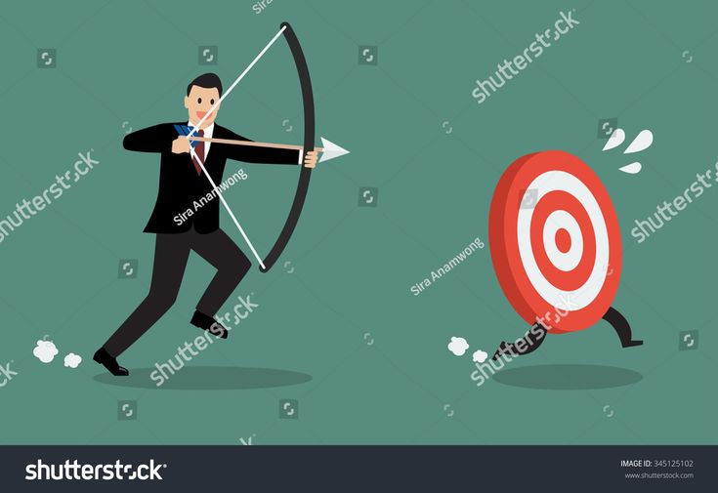
Run Archery
A quick run round the rules.

Slide 2
On Your Marks, Set, Go…..
Introduction to Run Archery
2 disciplines
2 team events
Set distance run
Hit/miss format
2 shooting positions
Penalty loops

Slide 3
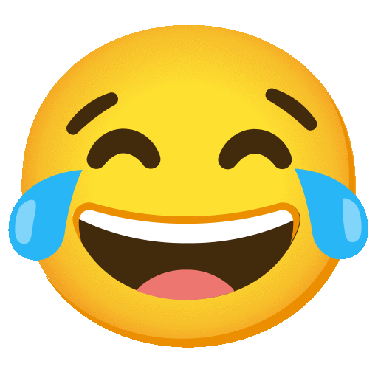
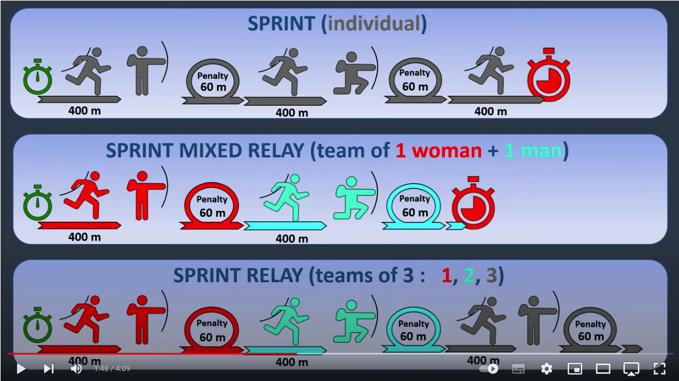
Sprint Event (Sprint…. )
Sprint Event (Sprint….

Slide 4
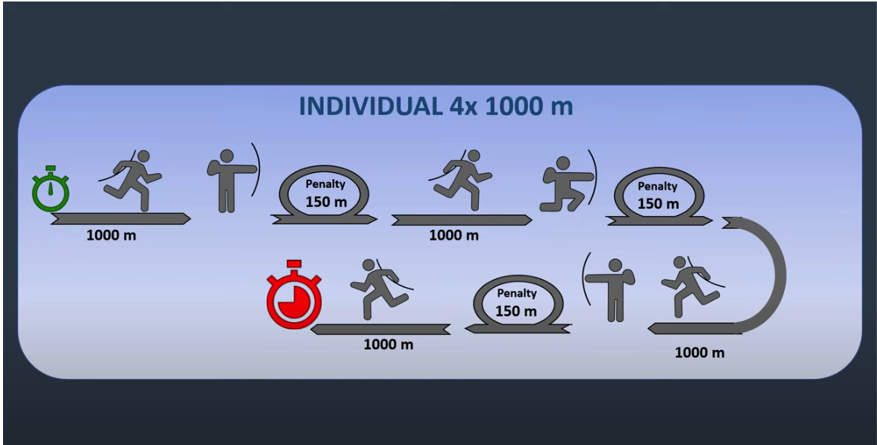
Individual 4k Event

Slide 5
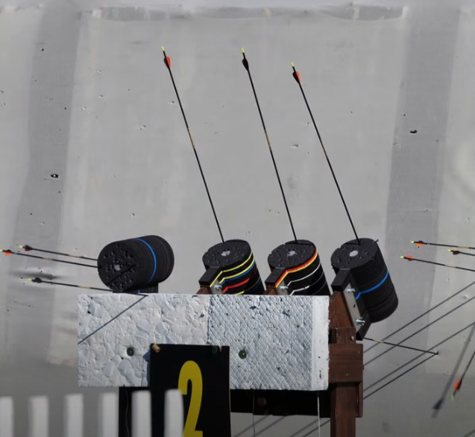
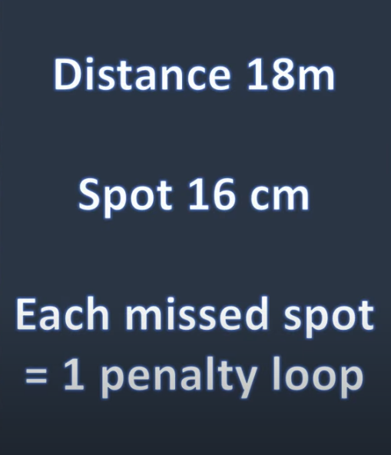
Targets – Hit/Miss format

Slide 6
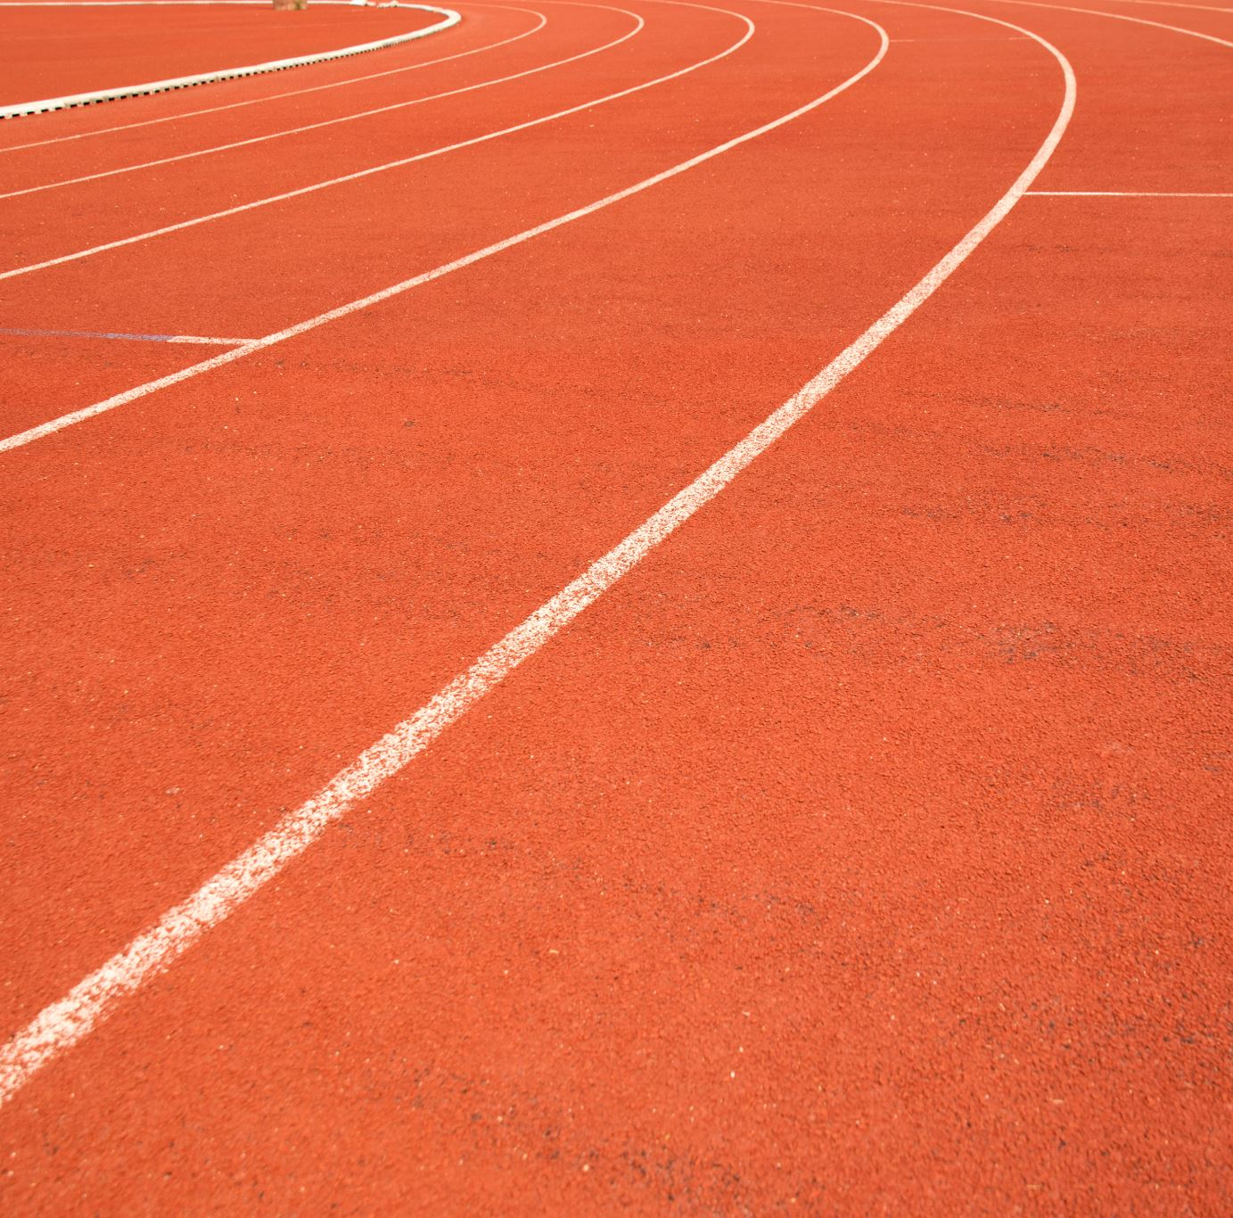
It is the spotters job to count the hits for the athletes and then instruct them to complete the penalty loops.
The loop spotter then counts how many penalty loops an athlete complete.

Slide 7
Equipment
All WA bowstyles except Compound
You can add any accessory listed within the rules for recurve but they are limited to 10cm out the front of the bow.
Athletes are allowed a back quiver (no side quivers allowed)
A harness to hold the bow on the back is also allowed
When running, if kit is carried on the back it must not be wider than the athletes' shoulders.

Slide 8
What do you do as the judge?
Check
Check the course – that means walking it and measuring the loops.
Check
Check the shooting range
Check
Check the target for size
Compare
Compare the arrow spotter’s notes and the penalty loop spotter’s notes to make sure the athlete has run the correct number of loops.
Apply
Apply any time penalties

Slide 9

More information:
WAE YouTube
WAE YouTube
World Archery Rules - Book 5

